Slide 1



DOOR SECURITY SYSTEM
GROUP MEMBERS:
20191IST0148 - SIRIMALLI SIVA KRISHNA
20191IST0150 - SNEHA M
20191IST0173 - YAMINI N
20191IST0187 - SAI MEGHANA J S
20191IST0193 - BANNURU VEERENDRA

Slide 2
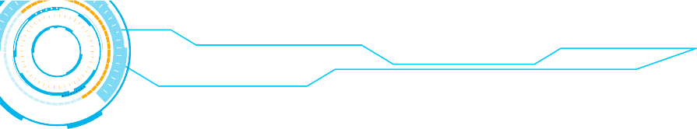




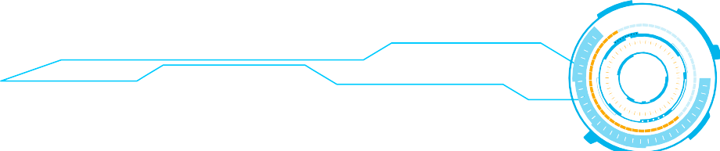


Our project presents a microcontroller based digital door lock security system using keypad which will provide complete security solution to lives and properties at homes, schools and offices.
The security system contains a 4X4 keypad input unit for entering the Personal Identification Number (PIN). It also contains a servo motor that serves as a switching for locking and unlocking the door and a programmed microcontroller that processes the input information and take appropriate action.
When a user enters a PIN into the security system installed at any entrance, the systemcaptures the PIN and compares it with the stored PINS for a match. If the captured PIN matches with any of the stored PINs, access granted and the door opens; otherwise, access denied and the door remains closed

Slide 3





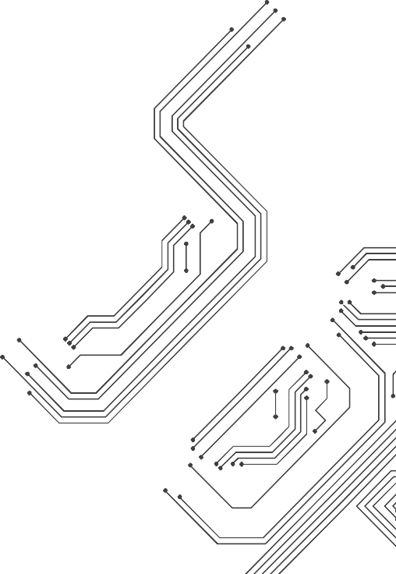



APPARATUS
10110110001010111000101110100111000110100
JUMPER WIRES
KEYPAD
ARDUINO UNO
SERVO MOTOR
Lock

Slide 4


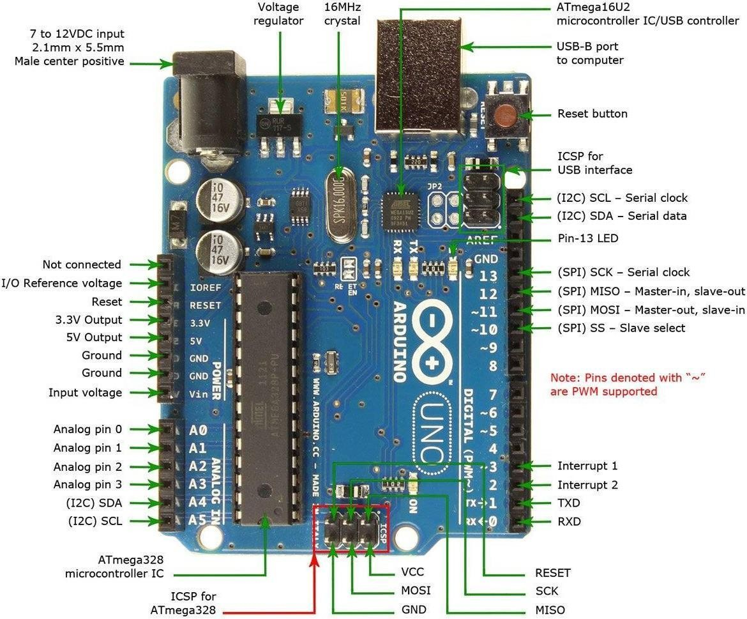
ARDUINO UNO
The board has ATmega328 microcontroller. It has 32kb flash memory and 2kb of SRAMand 1kb of EEPROM.It has 20 pins of which 6 are analog input pins and 14 (6 pins provides PWM voltage Jare digital I/O pins.Input voltage is 6-20V and operating voltage is 5V. We use pin 7 for 5V supply and pin 8 asGround, as most of the components work finewith SV.

Slide 5
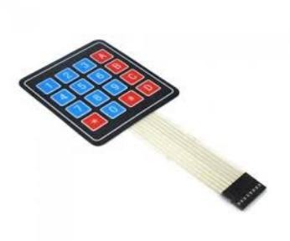
KEYPAD
The 4×4 matrix membrane keypad is most commonly used in projects. It follows a logical matrix where 16 keysare divided into 2 groups as ROW keys and COLUMN keys.. They can be connected using 8 pins from 1 to 8.

Slide 6


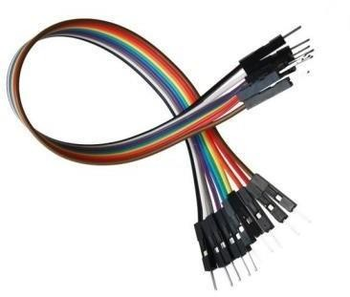
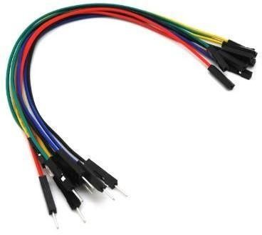

JUMPER
wires
A jump wire (also known as jumper wire, or jumper) is an electrical wire, or group of them in a cable, with a connector or pin at each end
,which is normally used to interconnect the components of a breadboard or other prototype or test circuit, internally or with other

Slide 7

SERVOMOTOR
A servo motor is a self-contained electrical device, that rotate parts of a machine with high efficiency . The output shaft of this motor can be moved to a particular angle, position and velocity that a regular motor does not have.

Slide 8
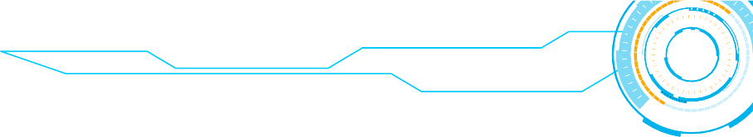
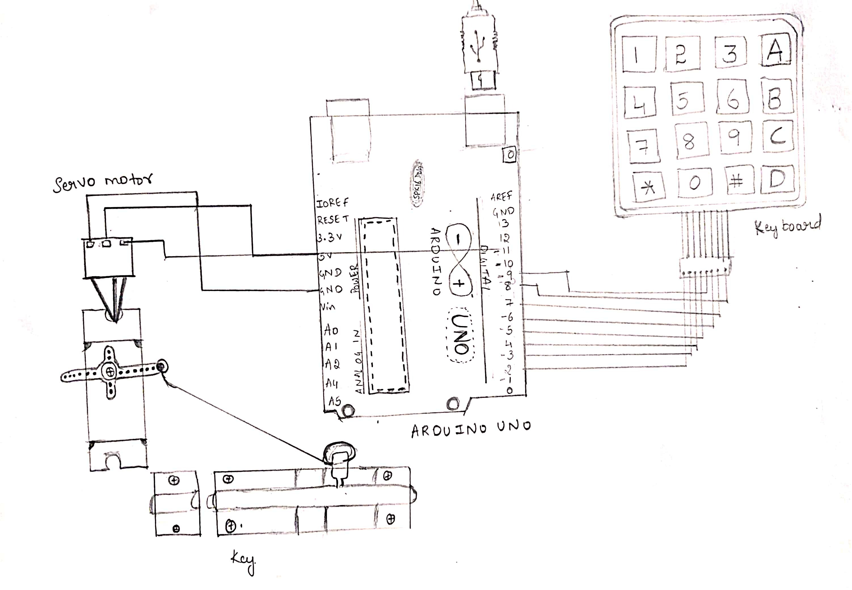
BLOCK DIAGRAM

Slide 9



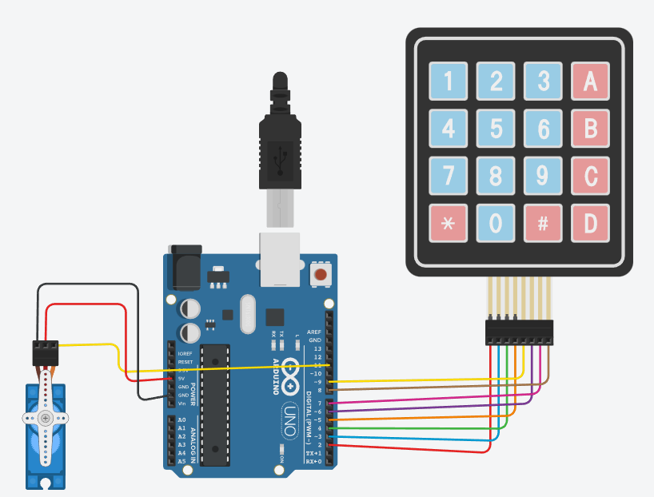
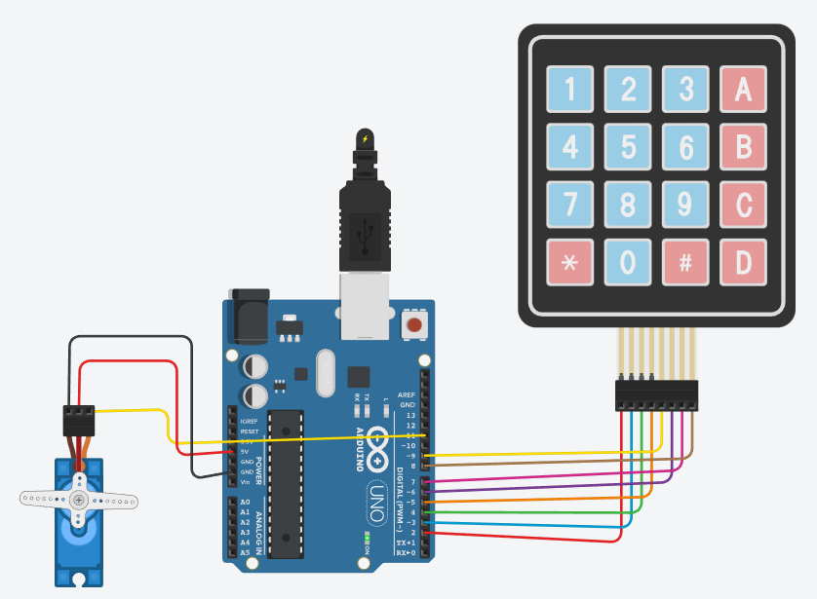
TINKERCAD DESIGN
Before executation
After executation

Slide 10
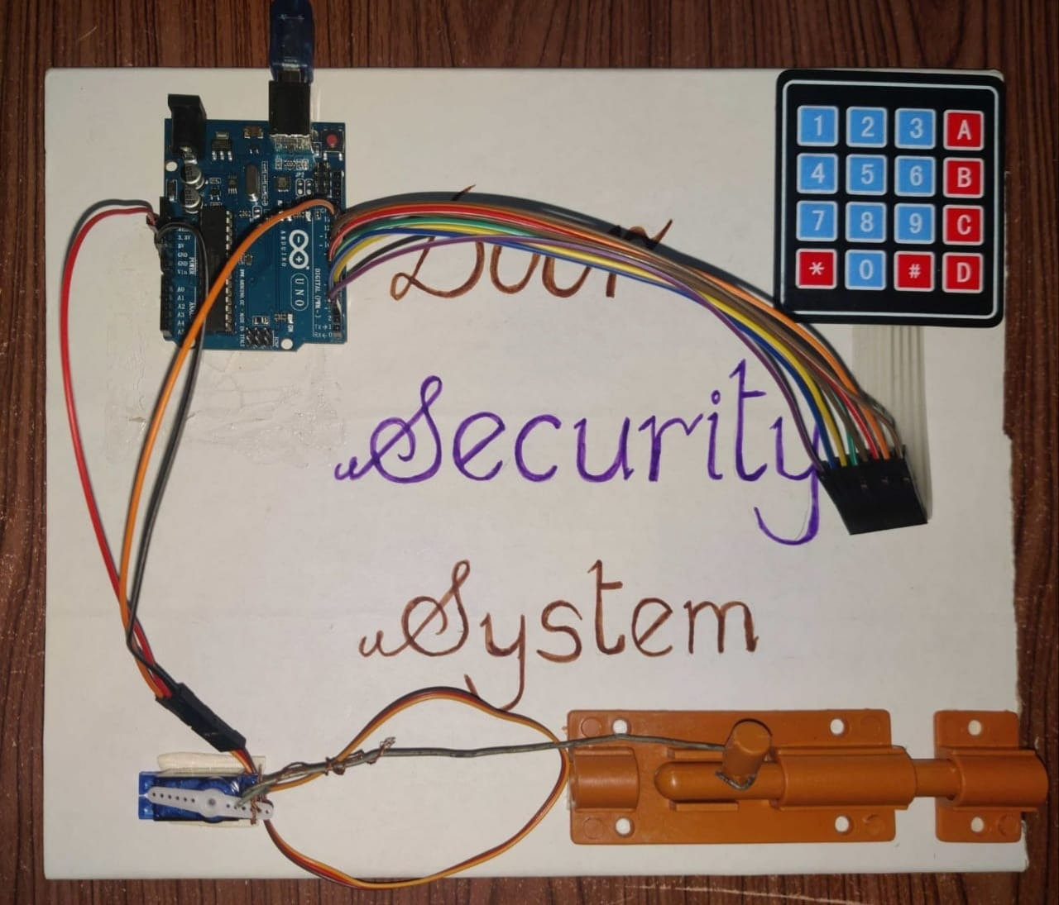
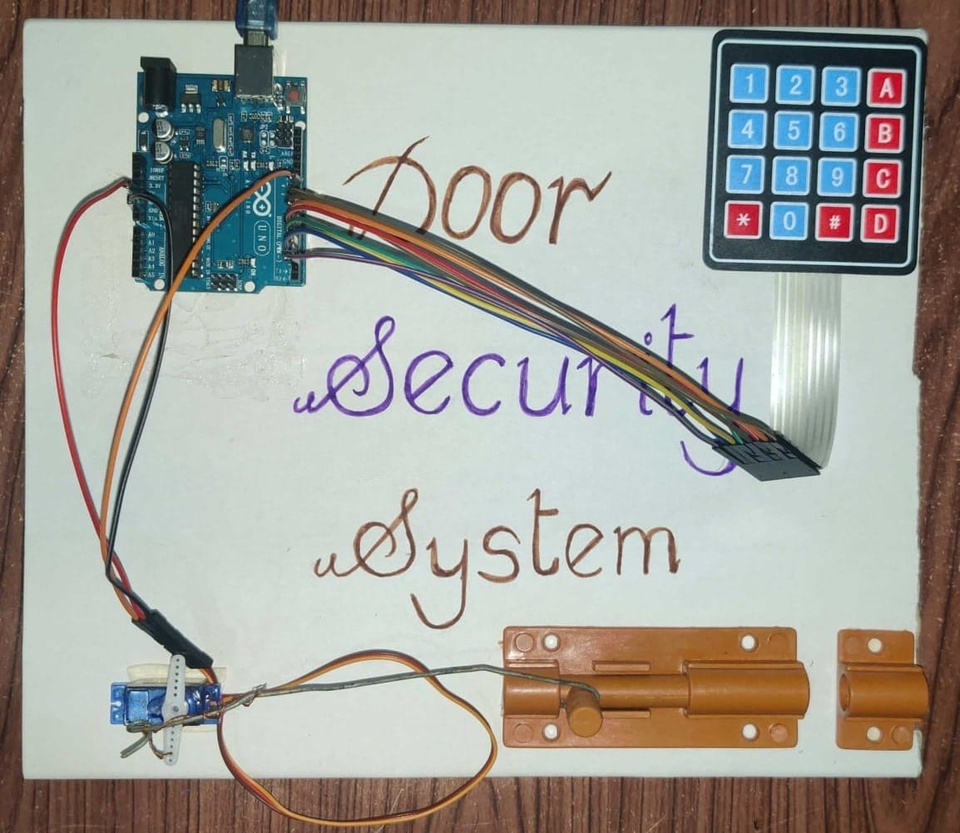
Prototype

Slide 11
Code
#include <Servo.h>
#include <Keypad.h>
Servo ServoMotor;
char* password = "6666";
int position = 0;
const byte ROWS = 4;
const byte COLS = 4;
char keys[ROWS][COLS] =
{
{'1','2','3','A'},
{'4','5','6','B'},
{'7','8','9','C'},
{'*','0','#','D'}
};
byte rowPins[ROWS] = {8, 7, 6, 9};
byte colPins[COLS] = {5, 4, 3, 2};
Keypad keypad = Keypad( makeKeymap(keys), rowPins, colPins, ROWS, COLS );

Slide 12
void setup()
{
ServoMotor.attach(11);
LockedPosition(true);
}
void loop()
{
for(;;)
{
char key = keypad.getKey();
if (key == '*')
{
position = 0;
LockedPosition(true);
}
if (key == password[position])
{
position ++;
}
if (position == 4)
{
LockedPosition(false);
}
delay(100);
}
}

Slide 13
void LockedPosition(int locked) { if (locked) { ServoMotor.write(11); } else { ServoMotor.write(180); } }

Slide 14

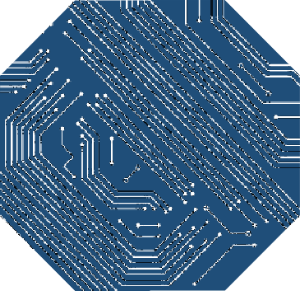
Applications
10110110001010111000101110100111000110100
10110110001010111000101110100111000110100
Used in doors of houses
10110110001010111000101110100111000110100
Used for jewellery or money boxes.
10110110001010111000101110100111000110100
10110110001010111000101110100111000110100
Used for vehicles
10110110001010111000101110100111000110100
Used in secured offices
wherever security is needed

Slide 15
The digital code lock performed as expected.
This digital code lock is very marketable because it is easy to use.• Comparatively inexpensive due to low power consumption, and highly reliable.
This is most prevalent form of digital lock as it uses numerical code for authentication.
The code lock is therefore particularly useful in door locks and equipment locks.
CONCLUSION
The digital code lock performed as expected.
This digital code lock is very marketable because it is easy to use.• Comparatively inexpensive due to low power consumption, and highly reliable.
This is most prevalent form of digital lock as it uses numerical code for authentication.
The code lock is therefore particularly useful in door locks and equipment locks.
Key words

Slide 16


